Slide 2
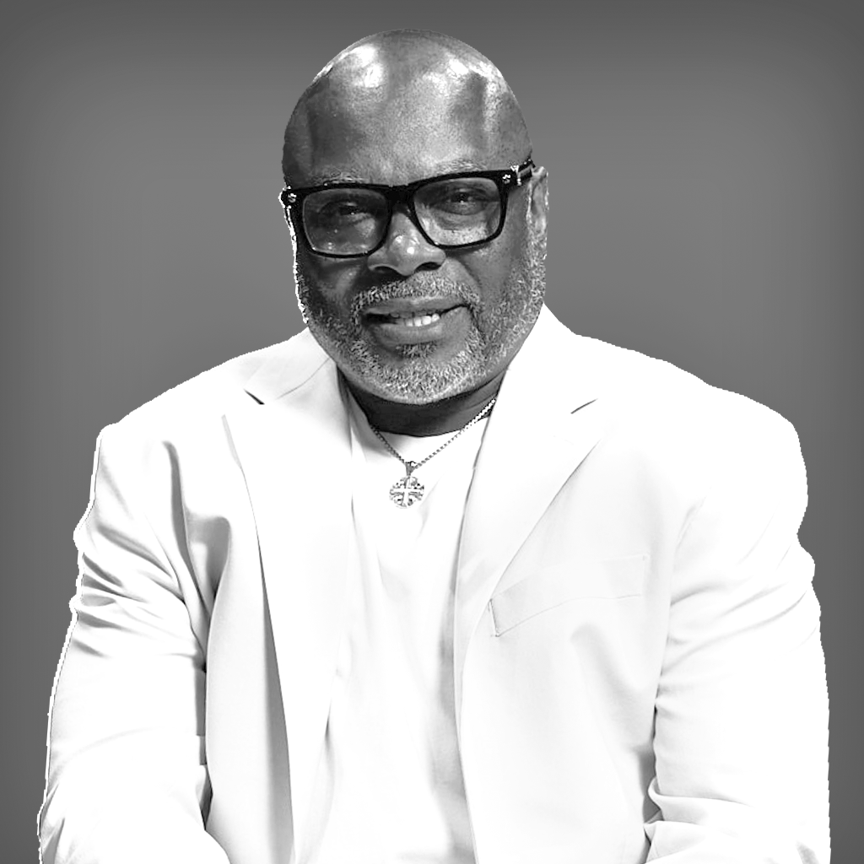
The Vision
RESURRECTION
LEAD PASTOR | RAY BROWN

Slide 3
OUR VISION: WHO WE ARE…
Servants of Christ, developing followers of Christ, who share the love of Christ.

Slide 4
OUR PURPOSE: WHY WE EXIST…
That people may know God, discover purpose, and make a difference.

Slide 5
OUR MISSION: WHAT WE DO…
Reaching the lost at any cost.

Slide 6
OUR THEME FOR THE YEAR
Advancing The Kingdom Agenda

Slide 7
Familiarize Yourself with the Theme of the Year (use it everywhere you go, make sure all events, meetings, and purposes meet this criteria)

Slide 8
Familiarize Yourself with the Theme (use it everywhere you go, make sure all events, meetings, and purposes meet this criteria)
Plan with Purpose (everything you do this year has to reflect the Theme)

Slide 9
Familiarize Yourself with the Theme (use it everywhere you go, make sure all events, meetings, and purposes meet this criteria)
Plan with Purpose (everything you do this year has to reflect the Theme)
Plan Conservatively (our focus is to make a difference even financially)

Slide 10
Familiarize Yourself with the Theme (use it everywhere you go, make sure all events, meetings, and purposes meet this criteria)
Plan with Purpose (everything you do this year has to reflect the Theme)
Plan Conservatively (our focus is to make a difference even financially)
Speak Life over the leadership, the ministry, and the events of the year

Slide 11
BECOMING AN EFFECTIVE LEADER 10 Things You Must Know…

Slide 12
1. KNOW YOUR WEAKNESS
Exodus 4:10
And Moses said unto the Lord, O my Lord, I am not eloquent, neither heretofore, nor since thou hast spoken unto thy servant: but I am slow of speech, and of a slow tongue.

Slide 13
2. KNOW YOUR CHURCH
Acts 2:41
Then they that gladly received his word were baptized: and the same day there were added unto them about three thousand souls.

Slide 14
3. KNOW YOUR PASSION
Acts 20: 23, 24
I only know that in every city the Holy Spirit warns me that prison and hardships are facing me. 24 However, I consider my life worth nothing to me; my only aim is to finish the race and complete the task the Lord Jesus has given me—the task of testifying to the good news of God’s grace.

Slide 15
4. KNOW YOUR STRENGTHS
Romans 15:1
We then that are strong ought to bear the infirmities of the weak, and not to please ourselves.

Slide 16
5. KNOW YOUR ROLE
Ephesians 4:11-13
So Christ himself gave the apostles, the prophets, the evangelists, the pastors and teachers, to equip his people for works of service, so that the body of Christ may be built up until we all reach unity in the faith and in the knowledge of the Son of God and become mature, attaining to the whole measure of the fullness of Christ.

Slide 17
6. KNOW YOUR TESTIMONY
Philippians 3:4,7
though I myself have reasons for such confidence.
If someone else thinks they have reasons to put confidence in the flesh, I have more: 5 circumcised on the eighth day, of the people of Israel, of the tribe of Benjamin, a Hebrew of Hebrews; in regard to the law, a Pharisee; 6 as for zeal, persecuting the church; as for righteousness based on the law, faultless. 7 But whatever were gains to me I now consider loss for the sake of Christ.

Slide 18
7. KNOW YOUR PASTOR
I Thessalonians 5:12
Now we ask you, brothers and sisters, to acknowledge those who work hard among you, who care for you in the Lord and who admonish you.

Slide 19
8. KNOW YOUR BIBLE
2 Timothy 3:15
and how from infancy you have known the Holy Scriptures, which are able to make you wise for salvation through faith in Christ Jesus.

Slide 20
9. KNOW YOUR GIFTS
1 Peter 4:10, 11
Each of you should use whatever gift you have received to serve others, as faithful stewards of God’s grace in its various forms.
11 If anyone speaks, they should do so as one who speaks the very words of God. If anyone serves, they should do so with the strength God provides, so that in all things God may be praised through Jesus Christ. To him be the glory and the power for ever and ever. Amen.

Slide 21
10. KNOW YOUR ENEMY
1 Peter 5:8
Be alert and of sober mind. Your enemy the devil prowls around like a roaring lion looking for someone to devour.

Slide 22
IT REQUIRES DEDICATION TO 10 THINGS:
Bible Study

Slide 23
IT REQUIRES DEDICATION TO 10 THINGS:
Bible Study
Discipleship

Slide 24
IT REQUIRES DEDICATION TO 10 THINGS:
Bible Study
Discipleship
Evangelism

Slide 25
IT REQUIRES DEDICATION TO 10 THINGS:
Bible Study
Discipleship
Evangelism
Fellowship

Slide 26
IT REQUIRES DEDICATION TO 10 THINGS:
Bible Study
Discipleship
Evangelism
Fellowship
Giving

Slide 27
IT REQUIRES DEDICATION TO 10 THINGS:
Bible Study
Discipleship
Evangelism
Fellowship
Giving
6. Outreach

Slide 28
IT REQUIRES DEDICATION TO 10 THINGS:
Bible Study
Discipleship
Evangelism
Fellowship
Giving
6. Outreach
7. Prayer

Slide 29
IT REQUIRES DEDICATION TO 10 THINGS:
Bible Study
Discipleship
Evangelism
Fellowship
Giving
6. Outreach
7. Prayer
8. Servanthood

Slide 30
IT REQUIRES DEDICATION TO 10 THINGS:
Bible Study
Discipleship
Evangelism
Fellowship
Giving
6. Outreach
7. Prayer
8. Servanthood
9. Visitation

Slide 31
IT REQUIRES DEDICATION TO 10 THINGS:
Bible Study
Discipleship
Evangelism
Fellowship
Giving
6. Outreach
7. Prayer
8. Servanthood
9. Visitation
10. Worship

Slide 32
HOW WE PROVIDE LEADERSHIP IN OUR CHURCH
1. Pastor/Ministers
2. Elders
3. Deacons
4. Executive Leadership Team (ELT)
5. Ministry Leaders
6. Volunteers
7. Accountability and Support

Slide 33
"A leader is one who knows the way, goes the way,
and shows the way." - John C. Maxwell

Slide 34
THE FOUR C’s OF CHRISTIAN/BIBLICAL LEADERSHIP
• Calling
• Competence
• Confidence
• Character

Slide 35
How to Use CCB
RESURRECTION
Dorothy Pillow

Slide 36
Welcome to Resurrection Member Services
(Formerly Church Community Builder)
WEB Access
Access Member Services from any web browser:
https://myrbconline.org
Connect tab
Member Services
Direct link to:
https://resurrection.ccbchurch.com

Slide 37
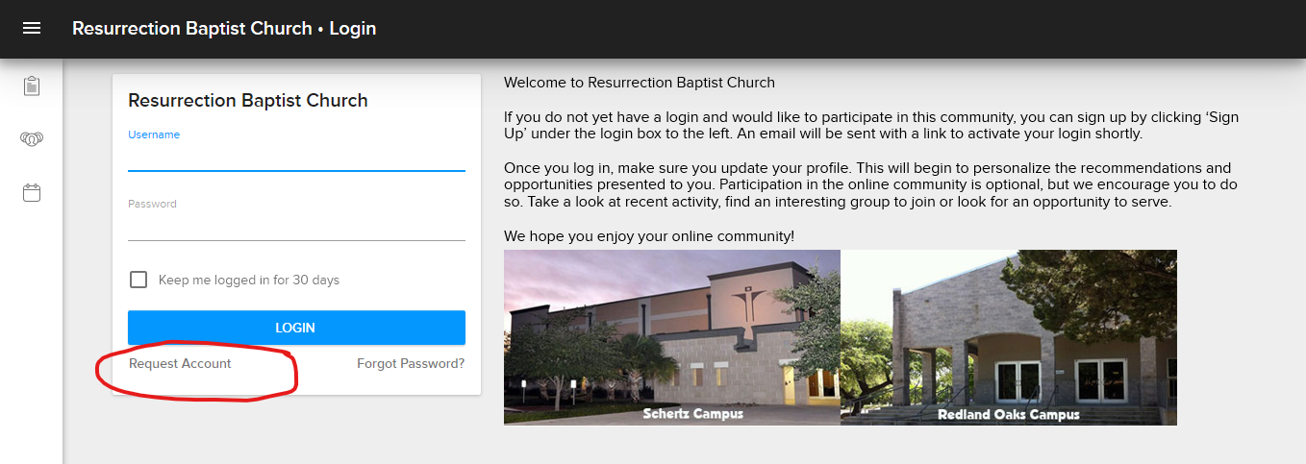
Initial Login Page https://resurrection.ccbchurch.com
If you don’t have a login you can Request Account here.

Slide 38
Lead App For Group Management
Only for Leaders in Leadership role within their groups!
iOS Apple Store
LEAD. by Church Community Builder, Inc.
https://apps.apple.com/us/app/lead/id1090541631
Android – Google Play Store LEAD. by Church Community Builder, Inc.
https://play.google.com/store/apps/details?id=com.ccbchurch.churchapp&hl=en_US.

Slide 39
CONGRATULATIONS!
You’re now Ready to Greet Your
Online Group Members
Questions?

Slide 40
How to Start or Join a LifeGroup
RESURRECTION
Minister Melissa Benson

Slide 42
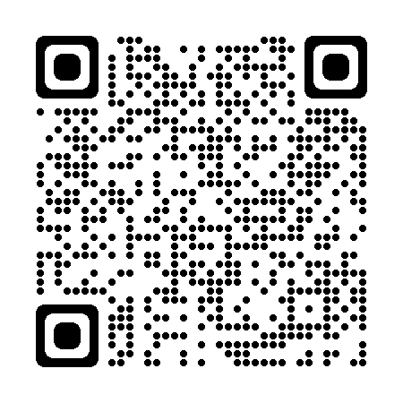
Life Groups
Sign-Up: Join/Host
“How to” Join/Host LG
myrbconline .com
Select Life Groups from Menu
Choose Life Group to Join/Host
Fill Out Form
Assigned to Life Group

Slide 43
How to Access Congregational
Care Resources
RESURRECTION
Pastor of Congregational Care | Jo Waters

Slide 44
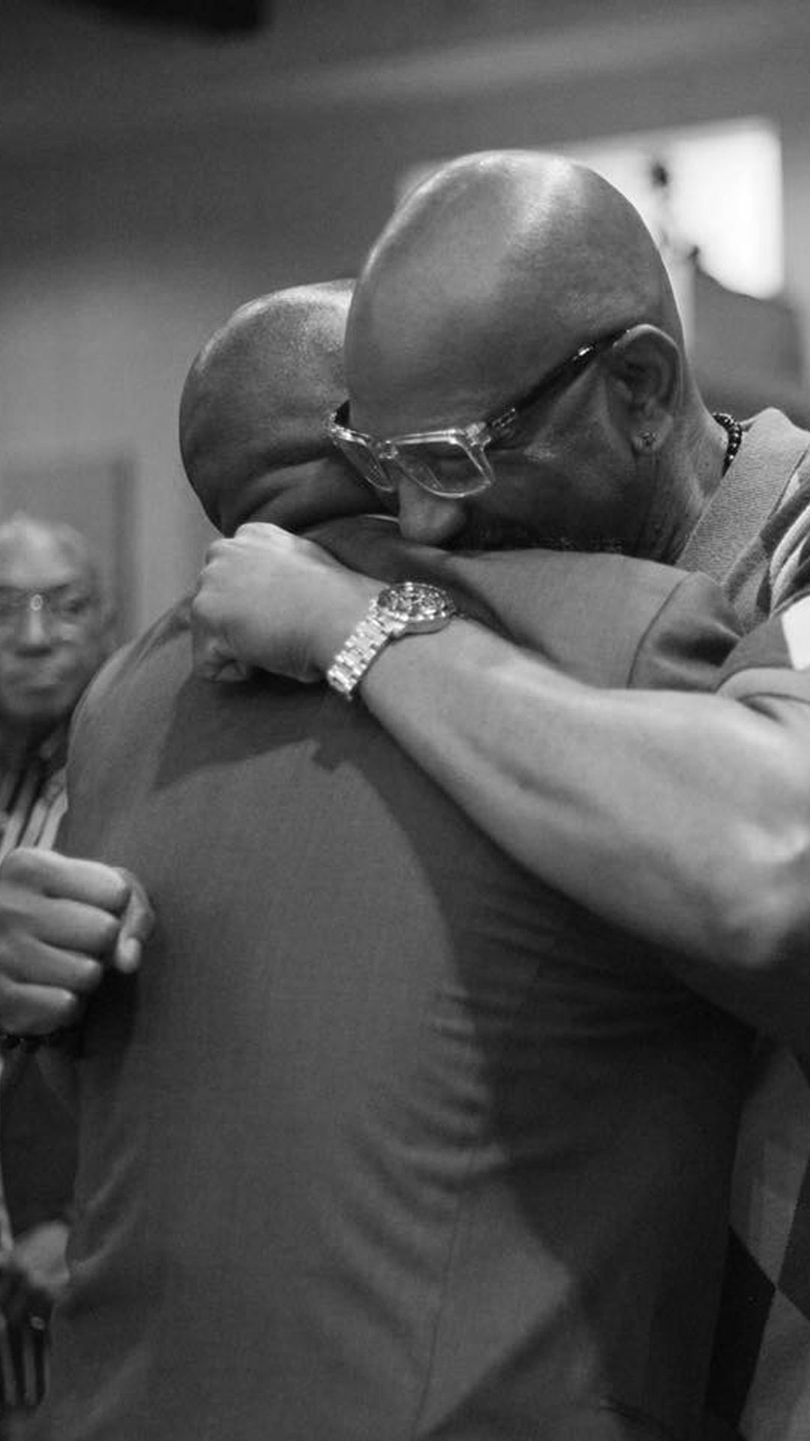
Next Steps Session Process
Welcome to Resurrection form completed; the new member is added to Next Step 101 in CCB.
CCB information from Belinda Robertson
Welcome /information about Next Step Schedule
Reminders, materials, and RSVPs from CCare
Members who complete receive a Certificate; New Member Small Group.

Slide 45
Counseling Referral Request Process
Access Resurrection Website: www.myrbconline.org -Click “Counseling.
Complete the Counseling Referral Request Form; the selected counselor will schedule three sessions
Support Groups available on Wednesdays at 6:30 p.m.: GriefShare (griefshare.org);
DivorceCare (divorcecare.org) on Thursdays at 6:30 p.m.

Slide 46
Baptism Registration Process
Access www.myrbconline.org - Click Connect then Baptism Request
Congregational Care provides information and schedules the candidate.
Baptisms are on the 1st Sunday-Schertz at 10:30 a.m. and 2nd Sunday-Redland Campus (beginning in April 2024).

Slide 47
RBCCARES Process
Text RBCCARES:
Text “RBCCARES” 830.689.8074
Complete Form for ministry needed:
The Ministry lead for the selection responds
Special note: If this is an emergency, please dial 911 for assistance.
Access website www.myrbconline.org Click RBCCARES
Selected ministry and will address the needs/requests.
*Bexar County Hotlines and Helplines available on RBCCARES form

Slide 48
How to Get Your Ministry Requests Approved
RESURRECTION
Executive Pastor | Dr. Anthony Cobbs

Slide 49
Part I: General Request Information
Login to CCB, select Groups, type and select your Ministry Group Name (Greeters)
Select calendar tab
Go to the calendar date for the event/activity or request due date and select add event.
Enter event information as requested (select repeat dates if applicable).

Slide 50
Part II: Rooms and Resources
Select Rooms and Resources black tab to the right.
Select Rooms or Resources: This is needed to select rooms, media, marketing, etc.
Drag rooms and resources to center as needed.
Click Create
You will be redirected, then click Publish tab and click public calendar and churchwide calendar.

Slide 51
Part III: Request Review and Approval
Requests are received by Assistant to the Executive Pastor (Jamee Soto)
Requests reviewed by the Executive Pastor (Dr. Anthony Cobbs)
We will notify event organizer by email if event is approved or not.
We will respond to your request within 24-48hrs. If not email Jamee Soto.

Slide 52
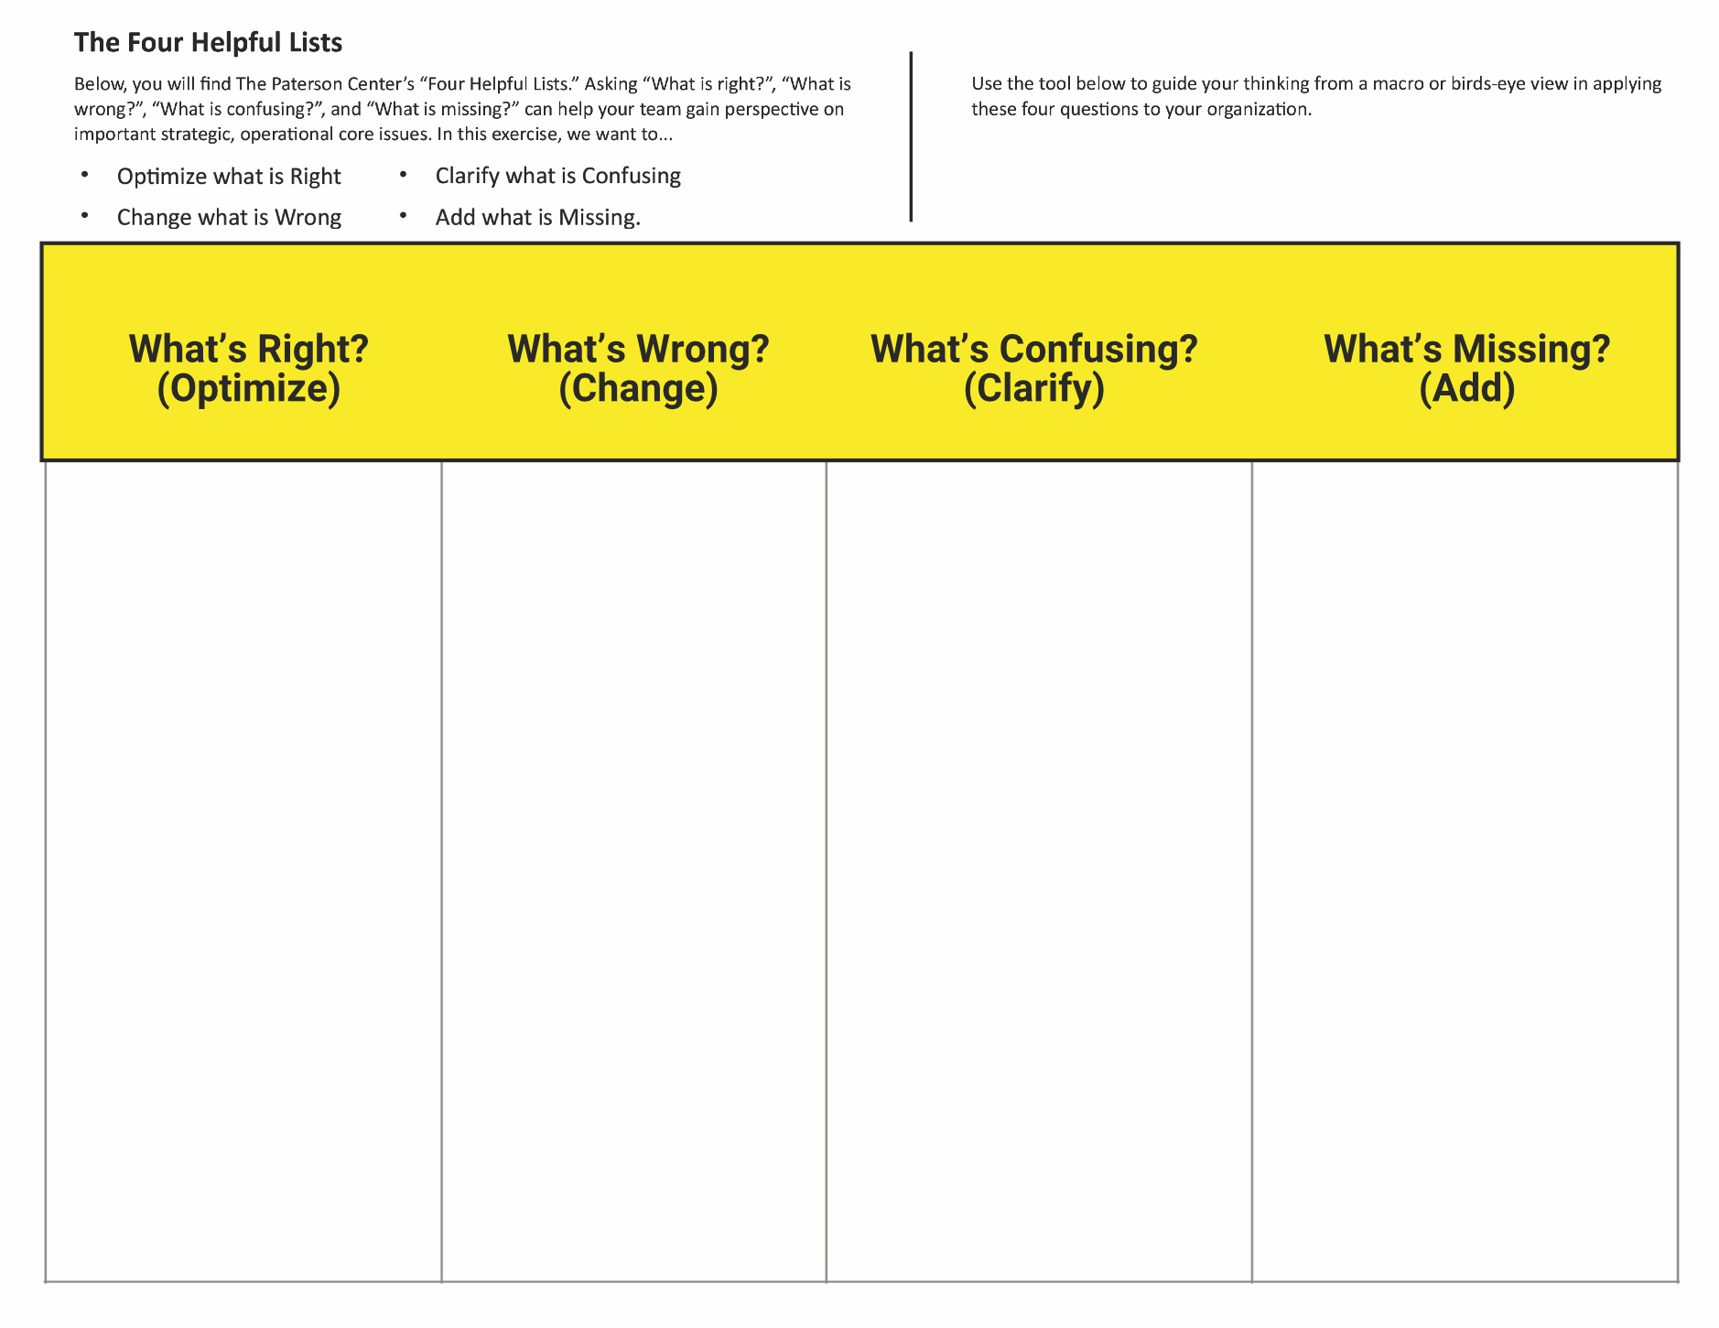

Slide 53
THANK YOU
RESURRECTION
RESURRECTION

