Slide 1
WELCOME ACTIVITY
THE CROWN YOU WEAR
Take the sticky note and write one quality you admire about yourself (strength, kindness)
Find one person that you may not know well, introduce yourself and share your quality with your partner
After sharing, place your sticky note on the Words of Affirmation Poster

Slide 2
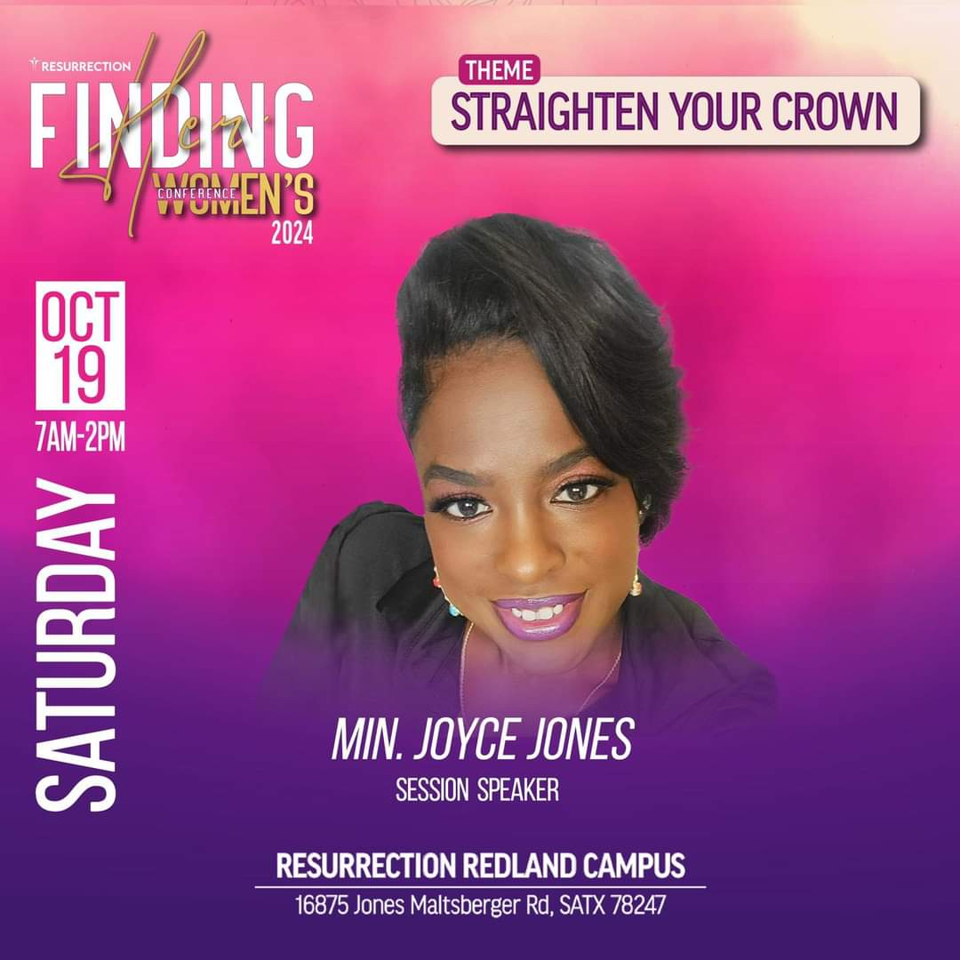
Straighten Your Crown in
Single Life

Slide 3
AGENDA
01
02
03
04
05
06
Appreciating the Journey of Single Life
Identifying a Tilted Crown & How to Fix it
Understanding our Worth
Navigating Social Media & Comparison Traps
Deciding if we are Single & Ready to Mingle
Celebrating Singlehood & Walking in Confidence

Slide 4
01
APPRECIATING THE JOURNEY OF SINGLE LIFE
Every woman’s journey is different
We have various experiences and emotions tied to this stage of life
We are fearfully & wonderfully made ~ Psalm 139:14
All things have become new ~ 2 Cor 5:17

Slide 5
01
APPRECIATING THE JOURNEY OF SINGLE LIFE
Partner
Activity
“This is My Story”
Share how did you get to singlehood &what has been the most rewarding part of your single journey?

Slide 6
02
WHAT CAN CAUSE YOUR CROWN TO TILT?
Societal Pressure
Loneliness
Unwanted attention
Comparison
Dating Frustration
Stereotypes
Work-Life Balance
Judgment from Others
Feeling Left Out
Future Uncertainty
Lack of Emotional Support
Body Image/ Self-Worth
Unforgiveness
Promiscuity
Notes:
Tilted crown is a metaphor
Common triggers that can your crown to tilt
Unforgiveness
Consequences to holding on to bitterness
Unresolved hurt can negatively impact our emotional and spiritual well being

Slide 7
02
WHAT CAN CAUSE YOUR CROWN TO TILT?
Group Activity
“Restoring My Crown”
In small groups, identify areas in your life that tilt your crown which causes you to feel less confident or whole
Discuss how letting go of these burdens can "straighten" your crowns

Slide 8
03
UNDERSTANDING YOUR WORTH
You are wonderfully made
You are a child of God
God has a plan for your life
You are chosen and dearly love
Your worth is found in Christ, not in the world
Your identity is secure in Christ

Slide 9
03
UNDERSTANDING YOUR WORTH
Self-Reflection
“Ruby Reflection”
Write down a promise from God or a personal value you hold dear. Keep your red ruby as a reminder of your worth.

Slide 10
03
UNDERSTANDING YOUR WORTH
Self-Reflection
“Words of Affirmation”
God created me with purpose and beauty, and I am precious in His sight.

Slide 11
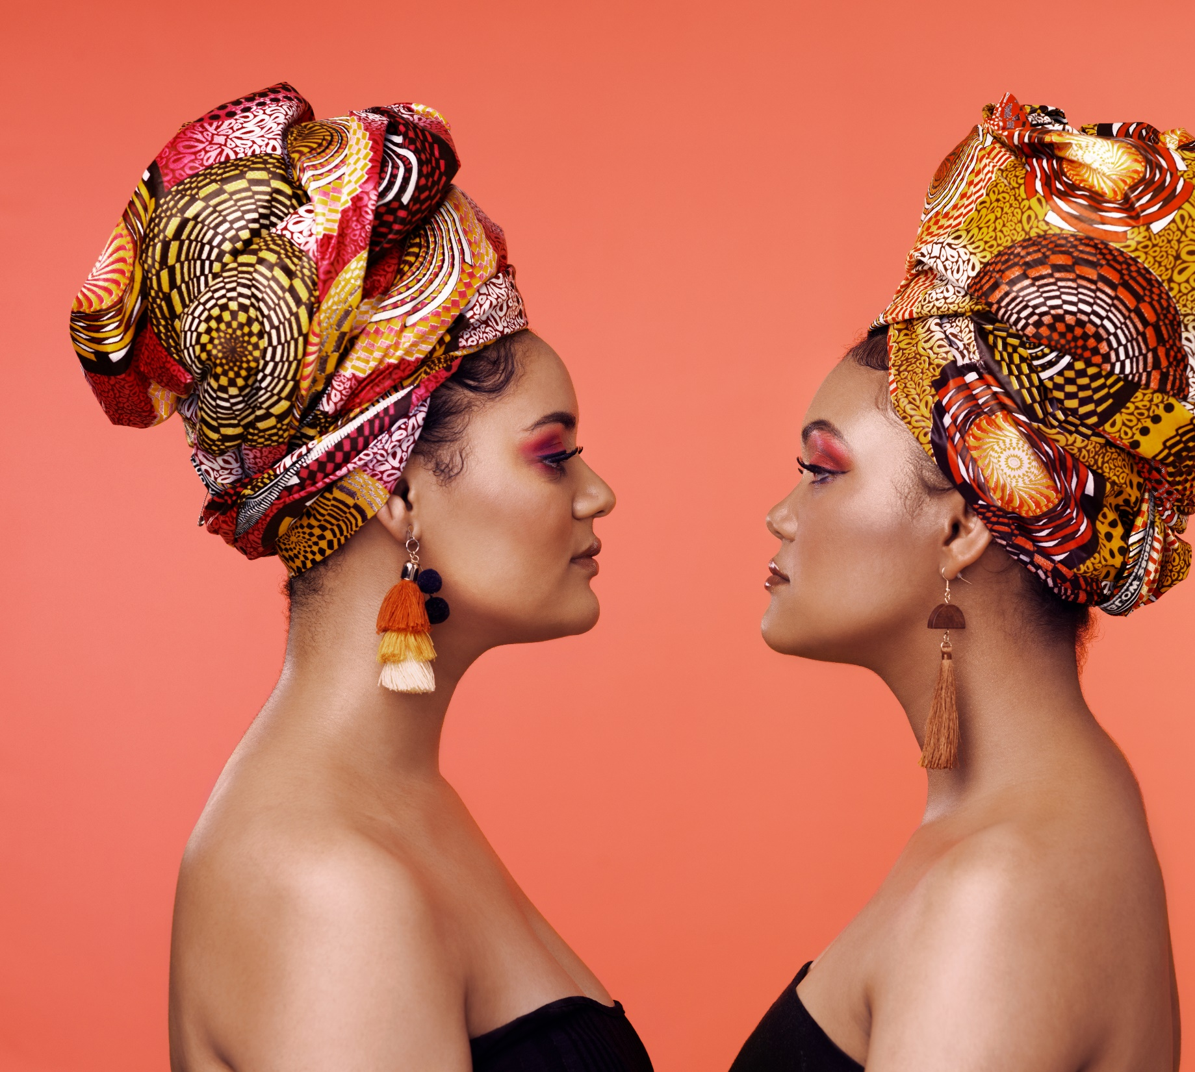
04
NAVIGATING SOCIAL MEDIA & COMPARISON TRAPS
“Comparison is the thief of joy”
Teddy Roosevelt
2 Corinthians 10:12

Slide 12
05
READY TO DATE AGAIN
Emotionally Healed
Comfortable being alone
Know what you want in a partner
Healthy self-esteem
Open to new experiences
Genuinely excited to meet new people

Slide 13
05
READY TO DATE AGAIN
Group Activity
“Heart Check”
Write down three qualities that you need in a partner and three signs you are ready to date again. In your group discuss what makes someone truly ready to seek a relationship.

Slide 14
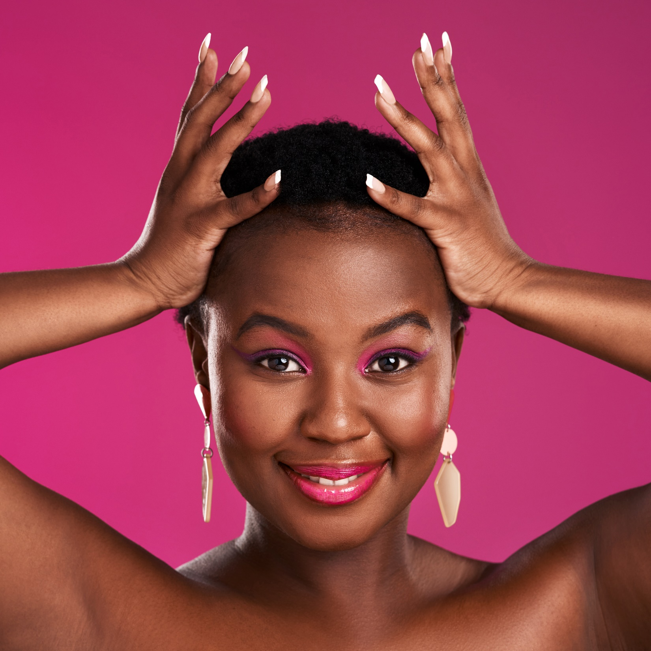
06
CELEBRATING SINGLE LIFE
Live abundantly
Focus on Personal Development
Prioritize Self-Care
Build Meaningful Relationships
Enjoy your freedom
Celebrate your Achievements

Slide 15
06
CELEBRATING SINGLE LIFE
Partner Activity
“Crown of Abundance”
Discuss with a partner how you plan to live more abundantly in your current season of life. What goals or dreams have you put on hold that you can now pursue?

Slide 16
Thank You

